Slide 1
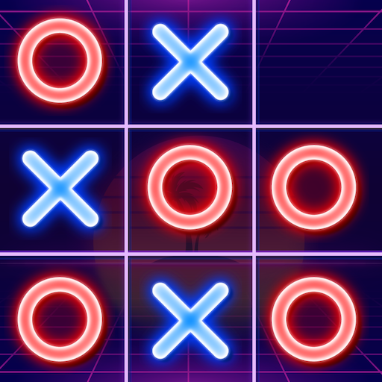
Optimizing Game Tree Search In Tic-Tac-Toe AI Using Minimax Algorithm And Alpha Beta Pruning Heuristics

Slide 2




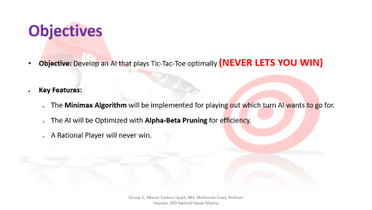
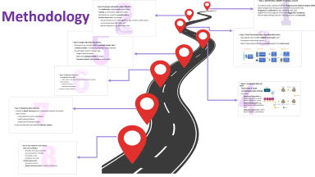
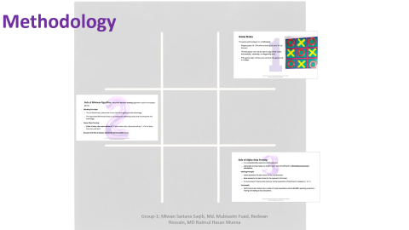
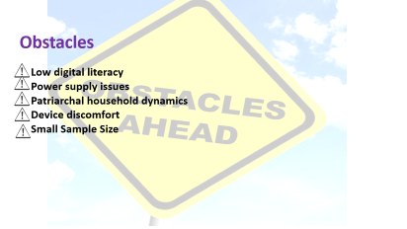
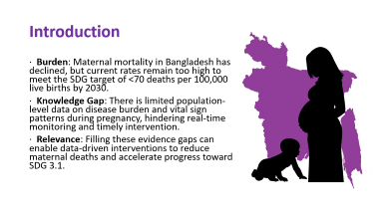

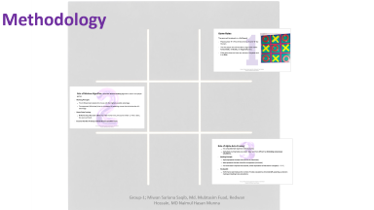
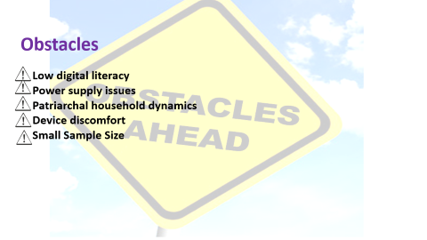
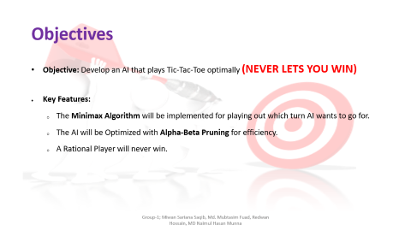

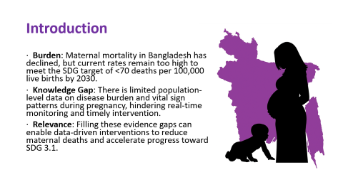
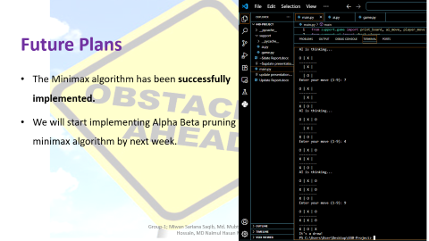
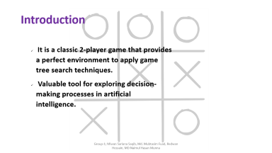
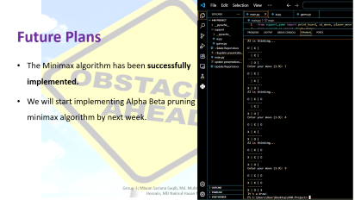
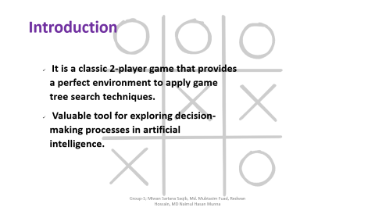
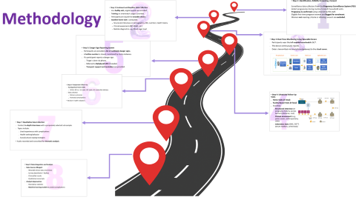
Tic-Tac-Toe AI

Slide 3
Tic-Tac-Toe AI

Slide 4
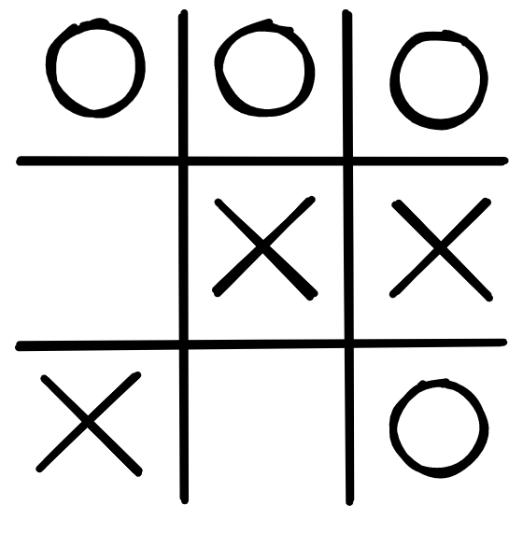
Introduction
It is a classic 2-player game that provides a perfect environment to apply game tree search techniques.
Valuable tool for exploring decision-making processes in artificial intelligence.

Slide 5

Objectives
Objective: Develop an AI that plays Tic-Tac-Toe optimally (NEVER LETS YOU WIN)
Key Features:
The Minimax Algorithm will be implemented for playing out which turn AI wants to go for.
The AI will be Optimized with Alpha-Beta Pruning for efficiency.
A Rational Player will never win.

Slide 6
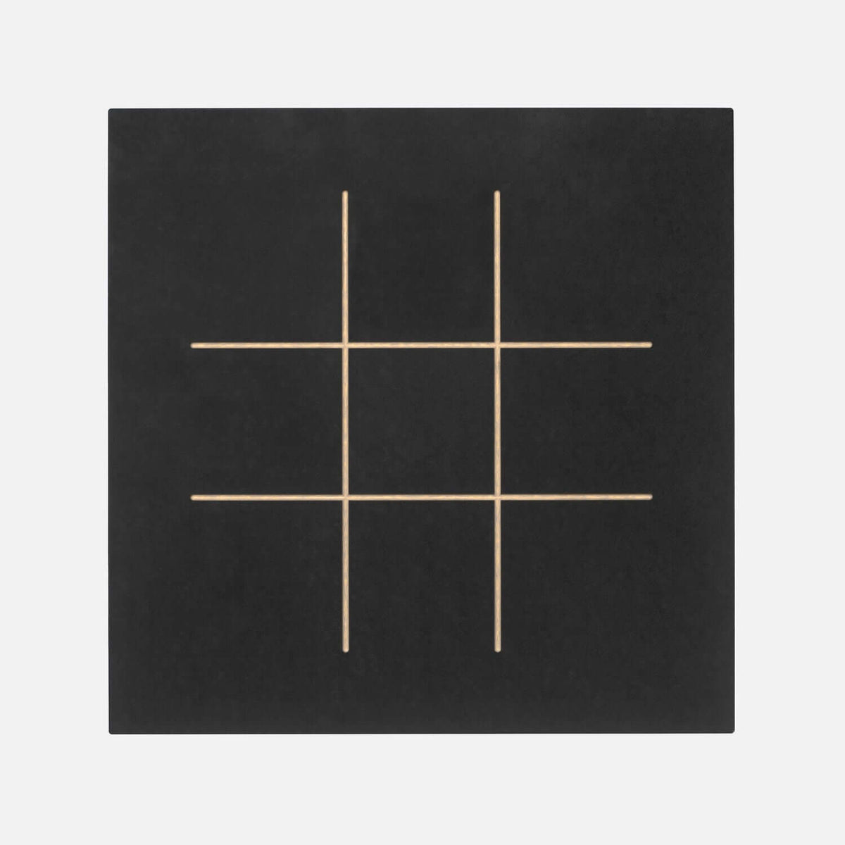
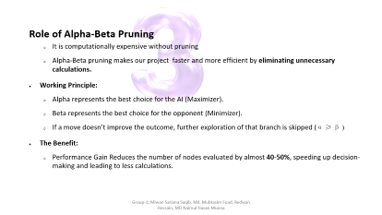
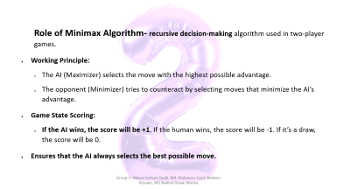
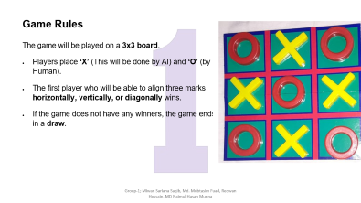
Methodology

Slide 7
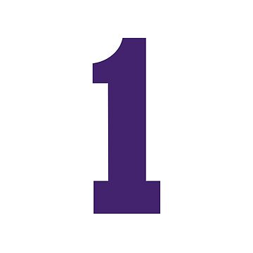
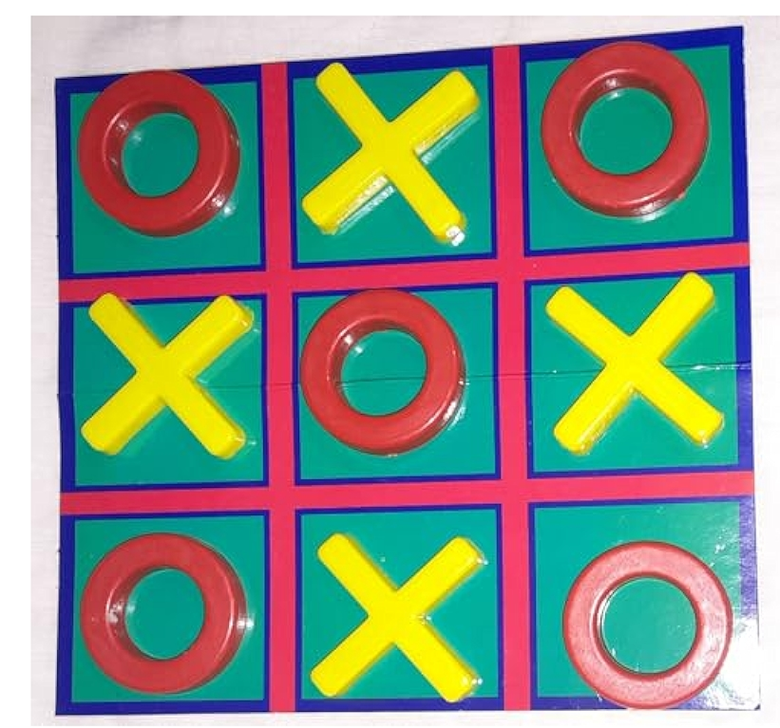
Game Rules The game will be played on a 3x3 board.
Players place ‘X’ (This will be done by AI) and ‘O’ (by Human).
The first player who will be able to align three marks horizontally, vertically, or diagonally wins.
If the game does not have any winners, the game ends in a draw.

Slide 8
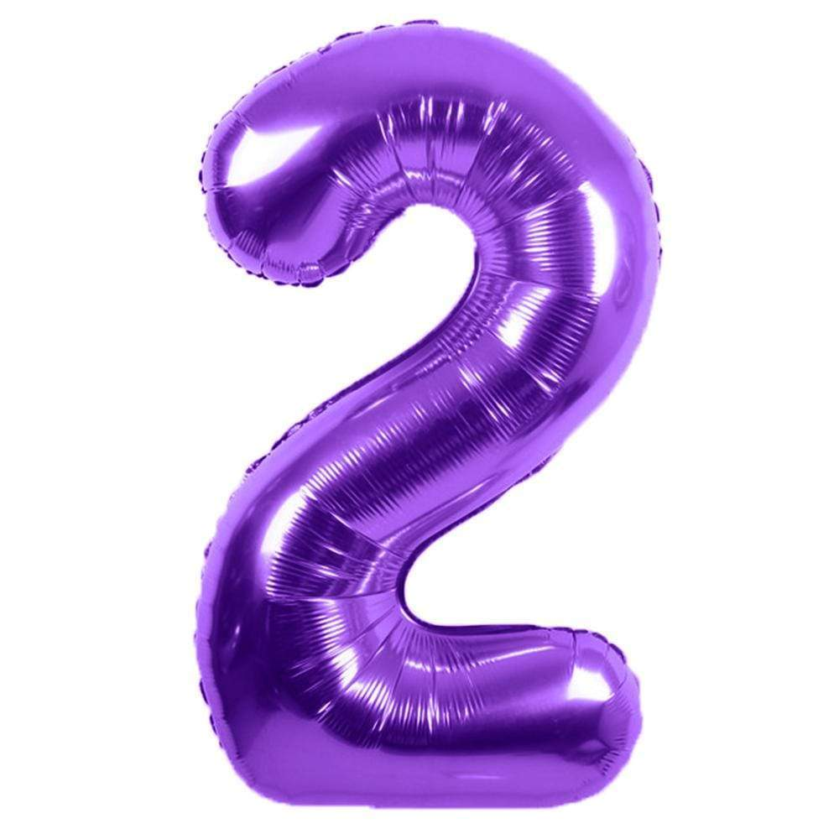
Role of Minimax Algorithm- recursive decision-making algorithm used in two-player games.
Working Principle:
The AI (Maximizer) selects the move with the highest possible advantage.
The opponent (Minimizer) tries to counteract by selecting moves that minimize the AI’s advantage.
Game State Scoring:
If the AI wins, the score will be +1. If the human wins, the score will be -1. If it’s a draw, the score will be 0.
Ensures that the AI always selects the best possible move.

Slide 9
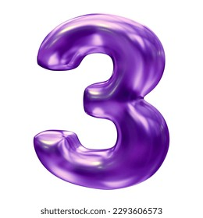
Role of Alpha-Beta Pruning
It is computationally expensive without pruning
Alpha-Beta pruning makes our project faster and more efficient by eliminating unnecessary calculations.
Working Principle:
Alpha represents the best choice for the AI (Maximizer).
Beta represents the best choice for the opponent (Minimizer).
If a move doesn’t improve the outcome, further exploration of that branch is skipped (α ≥ β )
The Benefit:
Performance Gain Reduces the number of nodes evaluated by almost 40-50%, speeding up decision-making and leading to less calculations.

Slide 10

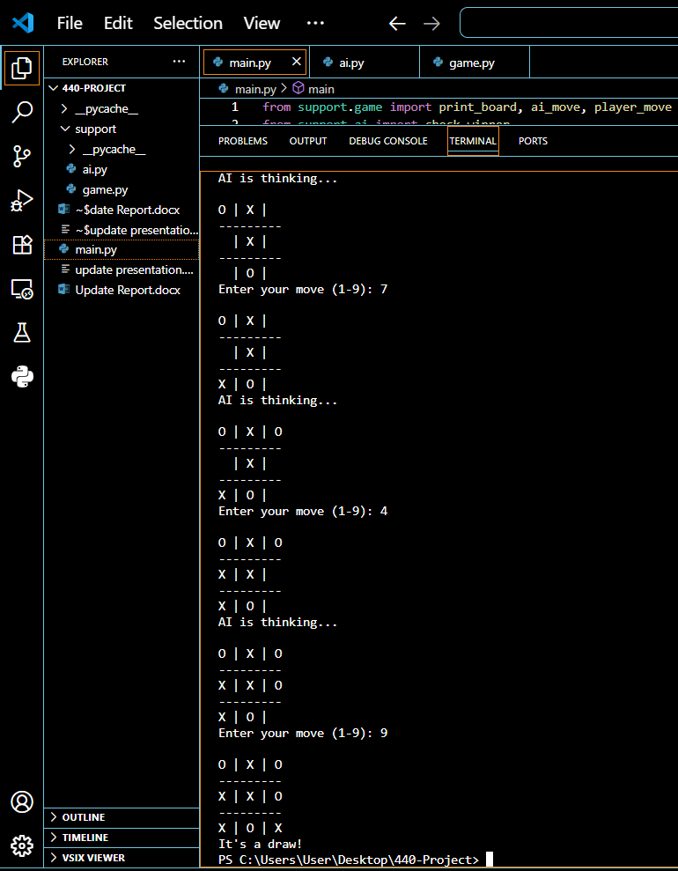
Future Plans
The Minimax algorithm has been successfully implemented.
We will start implementing Alpha Beta pruning in the minimax algorithm by next week.

Slide 11
Thank You ALL

